Slide 1
The art of persuasion
A powerful tool for effective communication skills

Slide 2
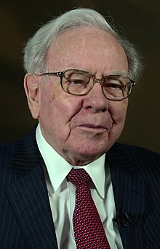
billionaire Warren Buffett……..
The only diploma he proudly displays in his office is a public-speaking certificate from a Dale Carnegie course.
He once told business students that improving their communication skills would boost their professional value by 50% — instantly.

Slide 3
persuasion is no longer just a “soft skill”…….
……..it is a fundamental skill that can help you attract investors, sell products, build brands, inspire teams, and trigger movements

Slide 4
Ideas are the currency of the twenty-first century.
The ability to persuade, to change hearts and minds, is perhaps the single greatest skill that will give you a competitive edge in the knowledge economy — an age where ideas matter more than ever.

Slide 5

AGE OF IDEAS
As our economy has evolved from an agrarian to an industrial to a knowledge-based one, successful people in nearly every profession have become those capable of convincing others to take action on their ideas.

Slide 6
The role of persuasion in our daily lives
Entrepreneurs persuade investors to back their startups.
Job candidates persuade recruiters to hire them.
Politicians persuade people to vote for them.
Leaders persuade employees to take specific plans of action.
CEOs persuade analysts to write favorable reports about their companies.
Salespeople persuade customers to choose their product over a competitor’s offering.

Slide 7
Aristotle’s influence on persuasion today
More than 2,000 years ago Aristotle outlined a formula on how to master the art of persuasion.
Many great communicators have used it throughout the ages to deliver some of the most influential speeches, presentations, and share their ideas with the world.

Slide 8
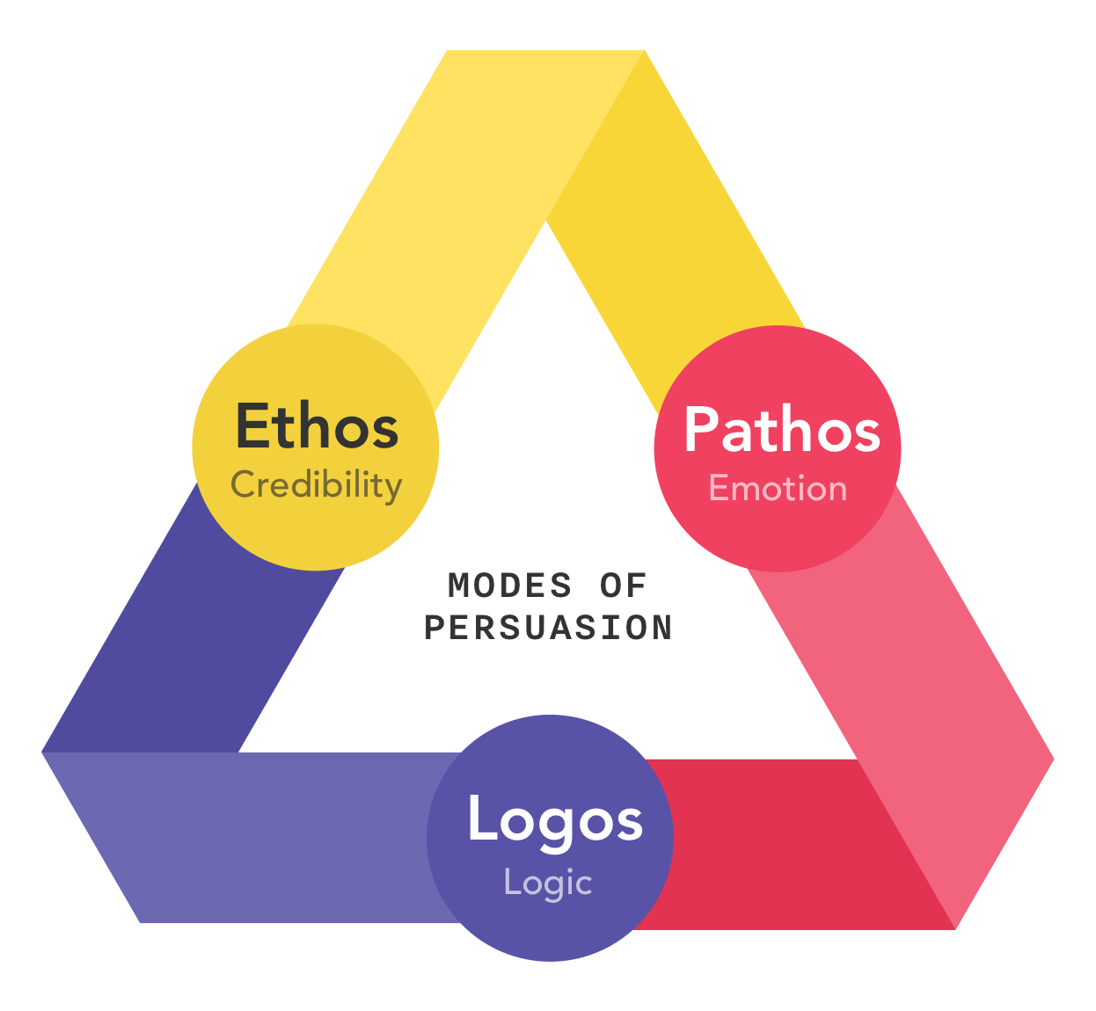
Key modes of persuasion

Slide 9
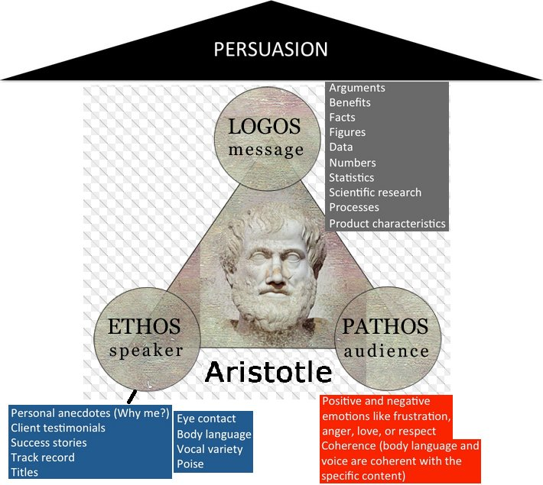

Slide 10
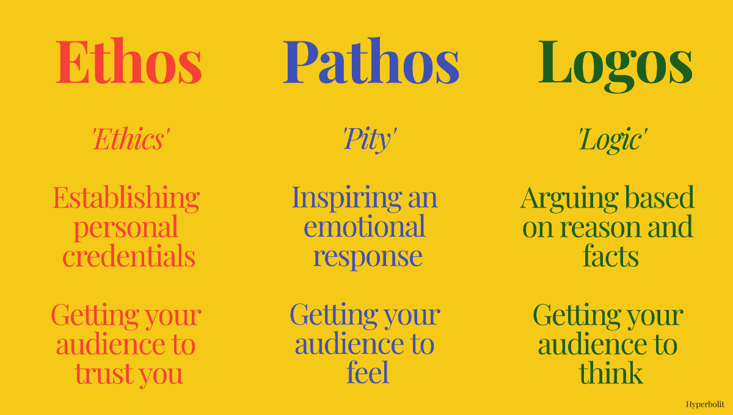

Slide 11
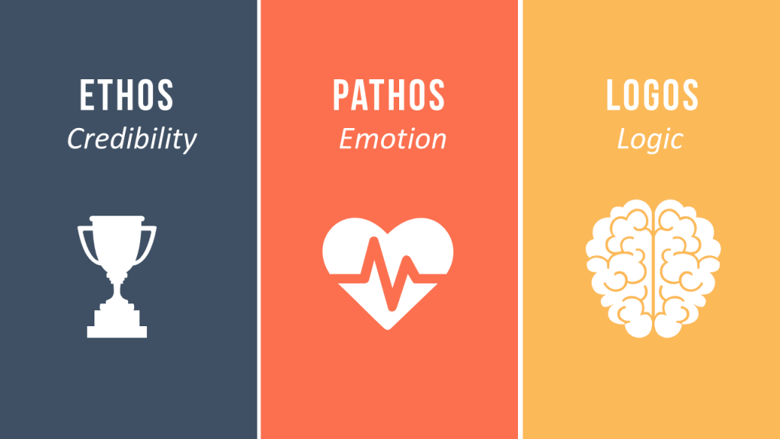

Slide 12
ETHOS….
Represents the part of a speech or presentation when the audience gains some insight into the speaker’s/persuader’s credibility.
Aristotle believed that if a speaker’s actions didn’t back their words, they would lose credibility, and ultimately, weaken their argument.

Slide 13
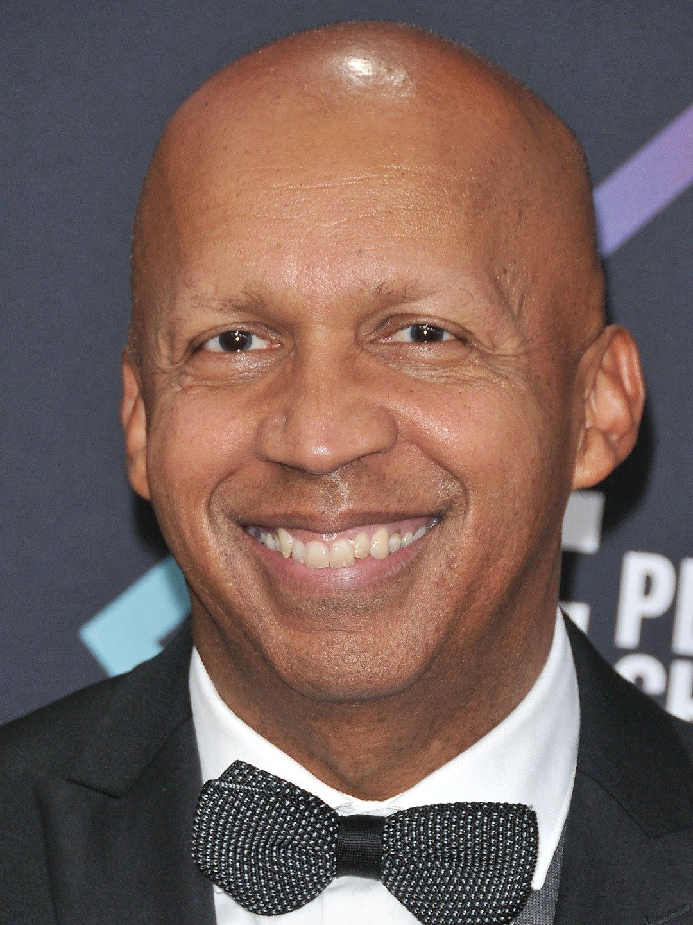
Ethos-Human Rights Attorney Bryan Stevenson
“I spend most of my time in jails, in prisons, with death row inmates. I spend most of my time in very low-income communities in the projects and places where there’s a great deal of hopelessness.”
You’ll notice that Stevenson does not list his degrees, accomplishments, and awards like he might on a résumé. Instead, he establishes his character for those in the audience who don’t know him. By doing so, he is building a sense of trust between himself and his listeners.

Slide 14
ETHOS-REASON TO TRUST…….
As humans, we are hardwired to search for reasons to trust another person, and we do so quickly….
After all, our ancestors had an instant to determine whether a stranger was friend or foe. A simple reminder that you are committed to the welfare of others will build your credibility before you lay out your argument.

Slide 15
Logos or reason
Why should your audience care about your idea?
What is in it for the audience? How do they benefit?
If it will save your audience money, for example, they’ll want to know how much it will save them and how the savings will be accomplished.
The same reasoning applies to making money. How will your idea help your listeners earn a profit? What steps do they have to take next? These are all logical appeals that will help you gain support. Use data, evidence, and facts to form a rational argument.

Slide 16


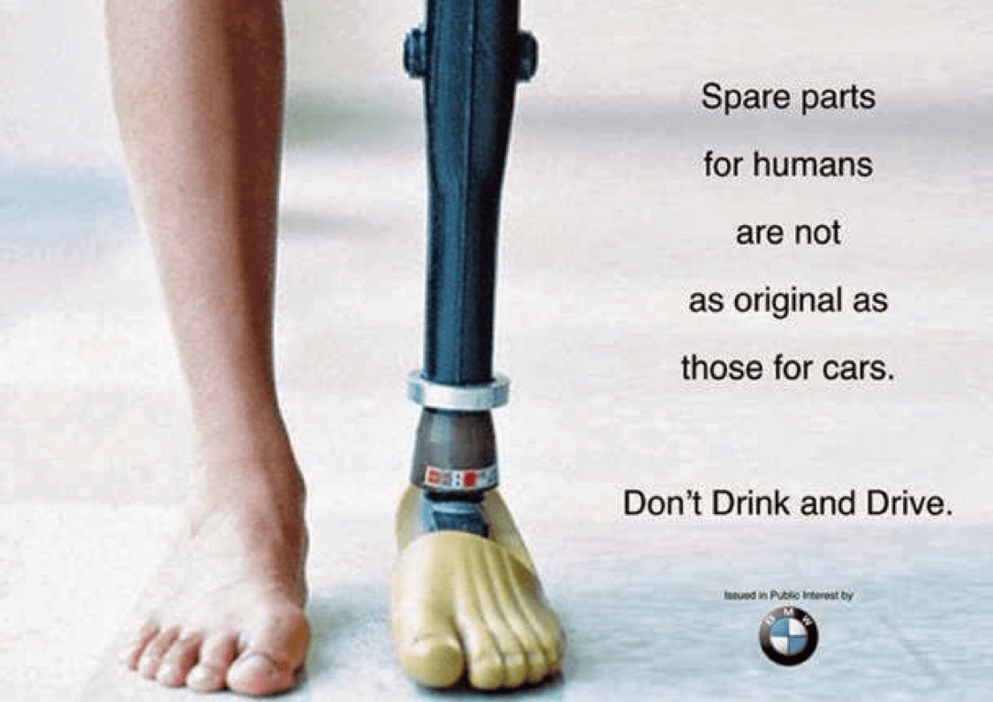

Pathos or “Emotion”
According to Aristotle, persuasion cannot occur in the absence of emotion.
People are moved to action by how a speaker makes them FEEL.
Feelings of joy, hope, fear, sympathy, excitement etc.…can be used to effectively persuade an audience

Slide 17
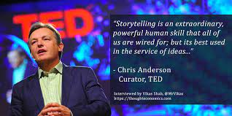
Story telling as a form of pathos….
“I found that stories made up 65% of the average speaker’s talk, whereas 25% went to logos, and 10% went to ethos. In other words, the winning formula for a popular TED talk is to wrap the big idea in a story.
The stories that can generate the best connection are stories about you personally or about people close to you. Tales of failure, awkwardness, misfortune, danger or disaster, told authentically, hastens deep engagement.” The most personal content is the most relatable”

Slide 18
Art of persuasion
https://youtu.be/lmR58_dqLxY

